Slide 1
Consumer Finance Protection Bureau Data

Slide 2
What the CFPB is
The Consumer Finance Protection Bureau keeps a database of all complaints submitted to them about consumer finance products.
The CFPB database has about 750,000 complaints in it.

Slide 3
Data Points in CFPB Database
Consumer finance product
ZIP code
State
Consumer issue with the product
Response of the company to the consumer
Timeliness of the complaint

Slide 4
Complaint Volume vs. State Population

Slide 5
Timely/Untimely and Disputed/Undisputed

Slide 6
Questions
When do consumers dispute a response?

Slide 7
Method
Use the American Community Survey (ACS) economic data to get economic data for zip codes.
This should give us some useful information about the origin of a complaint.
Construct a random forest classifier to predict a disputed complaint.

Slide 8
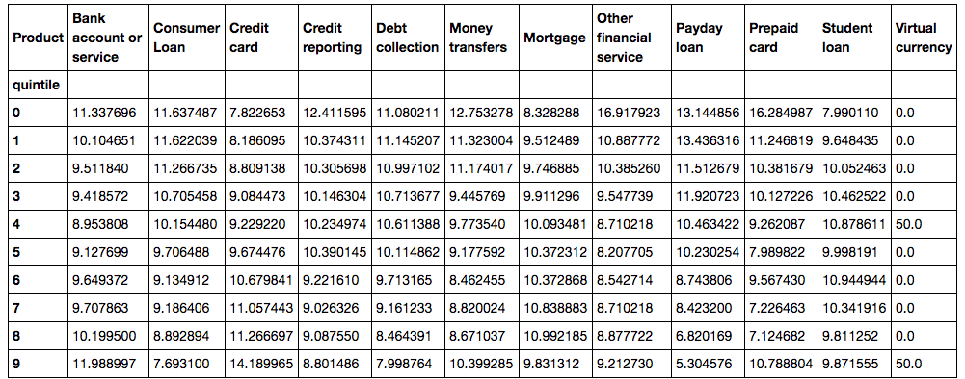
Income Deciles

Slide 9
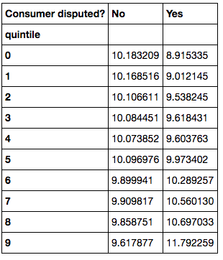
Disputes and Income Deciles

Slide 10

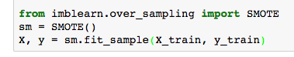

Building the Model

Slide 11
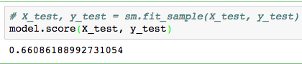
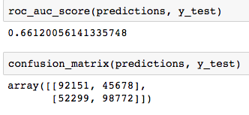
Results!

Slide 12
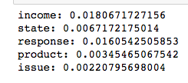
Results!

Slide 13
Results!
This is a moderate level of accuracy—not good, but better than guessing.
We can semi-reliably predict whether or not a particular complaint is disputed—this is valuable, because it means we can start looking at what features are important in determining whether a consumer will dispute it.

Slide 14
Future Directions
Model tuning
Raise the number of estimators.
Tinker with the various properties of a random forest.
more complex model—stacking and ensembling
SVM feeding a random forest, maybe? Who knows!

Slide 15
Questions?

